Slide 1
4. Knowledge Graph Schemas
John P. McCrae
CT5166

Slide 2
Course structure
9th Sep | Introduction to Knowledge Graphs | 21st Oct | Inductive reasoning
16th Sep | Models for Knowledge Graphs | 28th Oct | KG Creation (no lab on Monday)
23rd Sep | Querying and Serialization | 4th Nov | KG Alignment
30th Sep | Schemas | 11th Nov | Publishing and Linked Open Data
7th Oct | Deductive reasoning | 18th Nov | Linguistic Linked Open Data
14th Oct | No Lecture | 25th Nov | Enterprise Knowledge Graphs

Slide 3
RDF Schema

Slide 4
Types
We can use the rdf:type property to indicate what an object is:
:Paris a dbo:Location , dbo:Settlement , owl:Thing .
:London a dbo:Location , dbo:Settlement , owl:Thing .
Wouldn’t it be great if we could avoid this repetition?
Thing
Location
Settlement
Paris
London

Slide 5
Subclasses
dbo:Settlement rdfs:subClassOf dbo:Location .
Great! But how do we know that London is a Location??
We can infer it:
Thing
type
x
y
Location
subClassOf
y
z
type
Settlement
x
z
Paris
London

Slide 6
Subproperties
country
London
UK
p
x
y
locatedIn
subPropertyOf
p
q
q
x
y

Slide 7
Domain and Range
Properties may have a domain/range that give a type to the subject/object of a property
:birthDate rdfs:domain :Person .
:birthDate rdfs:range xsd:date .
p
x
y
Important! This does not limit the domain/range.
:Galway :birthDate “1484”
Only infers that :Galway is a person
domain
P
z
type
x
z

Slide 8
Subproperties and Transitivity
Can also make hierarchies of properties
:birthDate rdfs:subPropertyOf :date .
Property and class hierarchies are transitive
:Settlement rdfs:subClassOf :Location .
:Location rdfs:subClassOf :Thing
Then
:Settlement rdfs:subClassOf :Thing

Slide 9
Open World Assumption
Our knowledge of the world is incomplete
Our KGs are too
We do not assume that the knowledge graph is complete
Example:
airport
Does Galway have an airport?
Dublin
Dublin Airport
airport
London
Heathrow
airport
Tokyo
Narita
We don’t know

Slide 10
Closed World Assumption
Opposite is the closed world assumption
Negation by Failure: Everything that we can’t infer from the graph is not true
Under OWA, we would have to have a statement for every city that it has no airport!

Slide 11
Rule Summary
x type y | y subClassOf z | x type z
x subClassOf y | y subClassOf z | x subClassOf z
x p y | p subPropertyOf q | x q y
x subPropertyOf y | y subPropertyOf z | x subProperty z
x p y | p domain z | x type z
x p y | p range z | y type z
RDF Schema has 7 other rules related to default typing and reflexivity.

Slide 12
Task
:Fruit rdfs:subclassOf :Food .
:Food rdfs:subclassOf :Thing .
:topping rdfs:subPropertyOf :contains ;
rdfs:domain :Food ;
rdfs:range :Food .
:contains rdfs:range :Ingredient .
:Tomato a :Fruit .
:Pizza :topping :Tomato .
How many triples can you infer from this file?

Slide 13
Shapes

Slide 14
Validation
Schemas* cannot fail so cannot detect errors in graph
We do want to validate our graphs
Graph shapes can also allow us to make assumptions about data
*RDF Schemas can’t fail, XML schemas are more like shapes

Slide 15
Shapes
Cardinality and list of properties
Location
lat : float [0..1]
long : float [0..1]
type
Airport
City
airportOf [1..1]
iataCode : string [1..1]
population : int > 0 [0..1]
Mandatory Properties
Optional Properties

Slide 16
Closed and Open Shapes
Closed:
All properties of the class are listed in the shape
Open:
Extra properties can be added without failing validation
Mixed: Class are declared as either open or closed

Slide 17
Shape Notation
A shape is:
⊤ True
𝚫_{N} The node is a member of N
𝚿_{cond} Some boolean condition holds (e.g., > 0)
𝜑₁∧ 𝜑₂ Both 𝜑₁ and 𝜑₂ hold
¬𝜑 𝜑 does not hold
→^{p}_{𝜑}{min, max} Between min and max edges of type p, whose objects satisfy 𝜑

Slide 18
Example in shape notation
Location
lat : float [0..1]
long : float [0..1]
type
Airport
City
airportOf [1..1]
iataCode : string [1..1]
population : int > 0 [0..1]
Location ↦ →^{lat}_{float} {0, 1} ∧ →^{long}_{float} {0, 1}
Airport ↦ →^{iataCode}_{string} {1, 1} ∧ →^{airportOf}_{City} {1, 1}
City ↦ →^{population}_{(int ∧ > 0)} {0, 1}

Slide 19
Shape evaluation
We can evaluate directed edge-labelled graph G = (V, E, L) for a node v ∈ V as follows:
[⊤]^{G,v} = 1
[𝚫_{N}]^{G,v} = 1 iff v ∈ N
[𝚿_{cond}]^{G,v} = cond(v)
[𝜑₁∧ 𝜑₂]^{G,v} = min([𝜑₁]^{G,v}, [𝜑₂]^{G,v})
[¬𝜑]^{G,v} = 1 - [𝜑]^{G,v}
[→^{p}_{𝜑}{min, max}]^{G,v} = min ≤ |{(v, p, u) ∈ E| [𝜑]^{G,u} = 1}| ≤ max
A valid graph is one where all shapes evaluate to 1 for all nodes of the matching type

Slide 20
Task
Model the following scenario with shapes:
A university with students and teachers and classes. Teachers and students take classes Students have a school year.
Classes have students and teachers

Slide 21
Solution
Student ↦ Person ∧ →^{studiesAt}_{University} {1, 1} ∧ →^{takesClass}_{Class} {1, ∞} ∧ →^{year}_{(int ∧ ≥ 1 ∧ ≤ 4)} {1, 1}
Class ↦→^{lecturer}_{Teacher} {1, ∞}
Teacher ↦ Person
University
Person
studiesAt [1..1]
Student
Teacher
year: int ≥ 1 ∧ ≤ 4 [1..1]
takesClass [1..∞]
lecturer [1..∞]
Class

Slide 22
Emergent Schemas
Sometimes we have the data but no (or incomplete) schema
Inferring the shape
Helps in writing schema
Discovers latent structure in the graph
Provides a summary of the data in the graph

Slide 23
Quotient Graph
Capital
Gatwick
London
Dublin Airport
Dublin
Capital
Dublin Airport
Gatwick
Heathrow
Heathrow
UK
Ireland
London
Dublin
Galway
Ireland
UK
Galway

Slide 24
Quotient Graph
A quotient graph, Q=({V_{j}}, E’), is a partition of the graph satisfying
V = V₁⊔ … ⊔ V_{n} (disjoint union)
(V_{i}, p, V_{j}) ∈ E’ implies there exists (v_{i}, p, v_{j}) ∈ E with v_{i} ∈ V_{i} and v_{j} ∈ V_{j}
Every graph has at least two quotient groups
The graph itself (V₁ = {v₁}, V₂ = {v₂}, …)
The single node graph (V₁ = V)

Slide 25
Identity

Slide 26
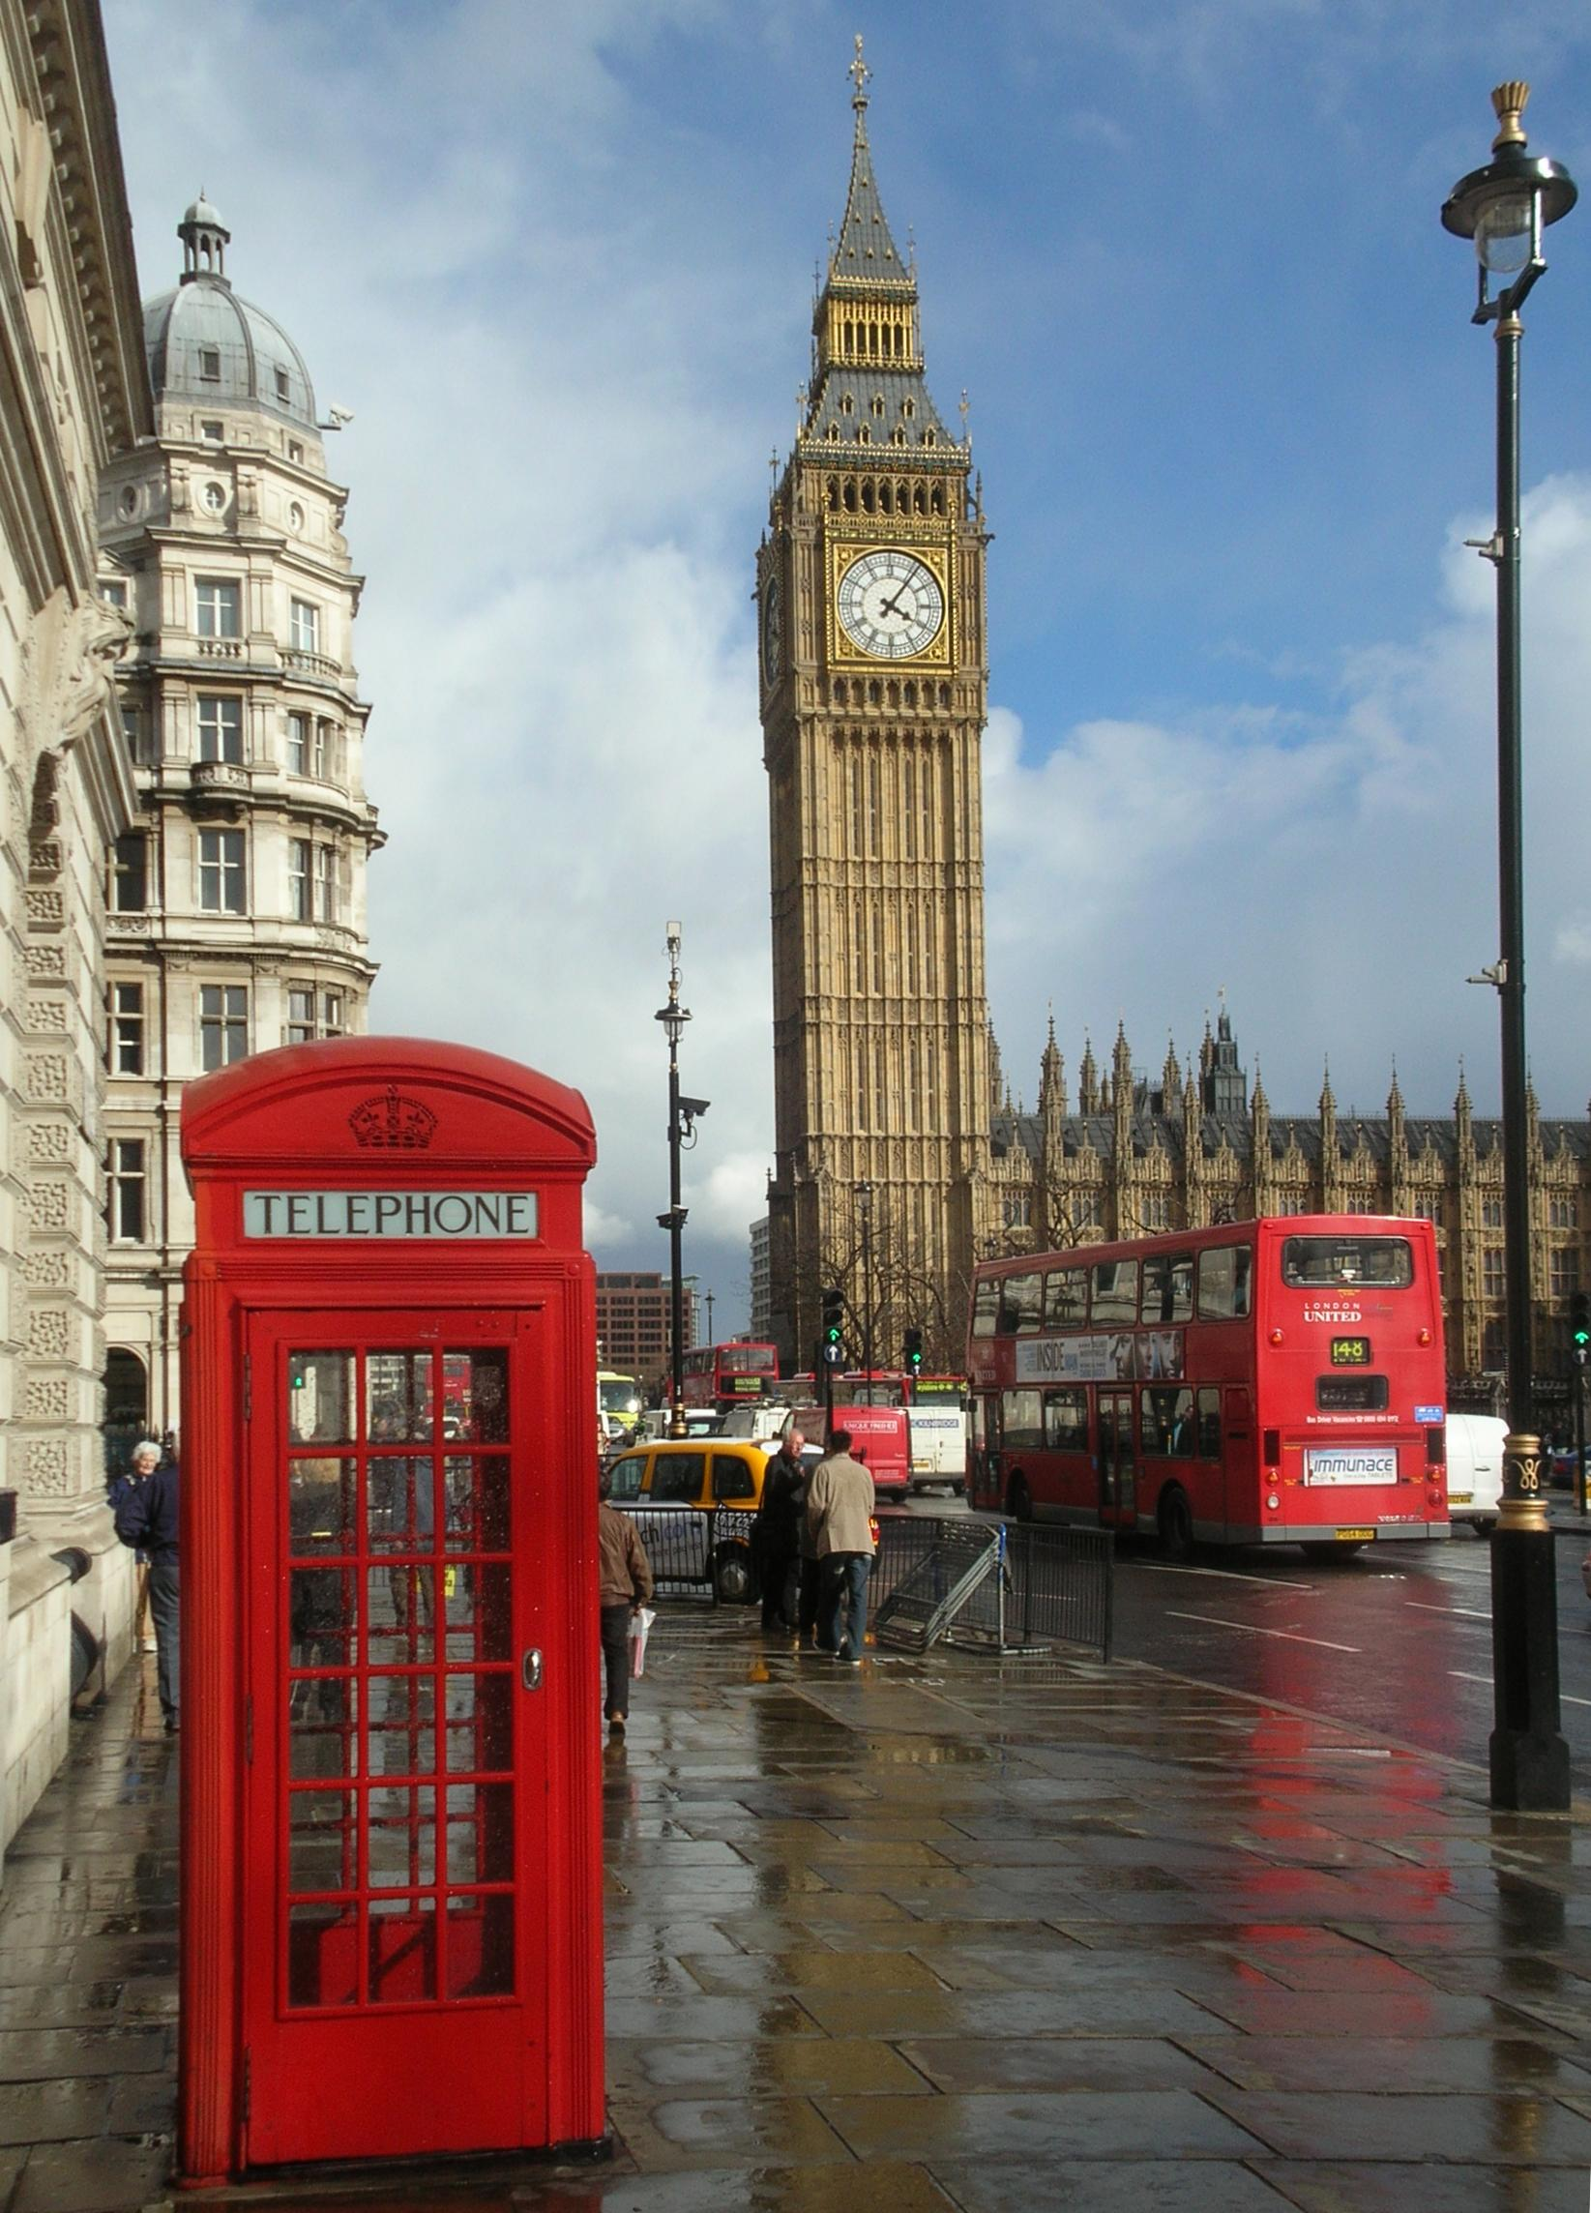

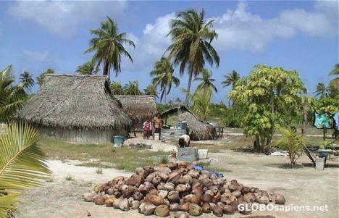
Identity
This one?
Or this one?
London
What about this one?

Slide 27
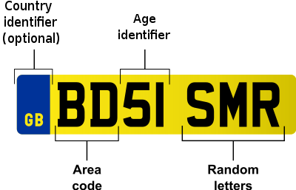
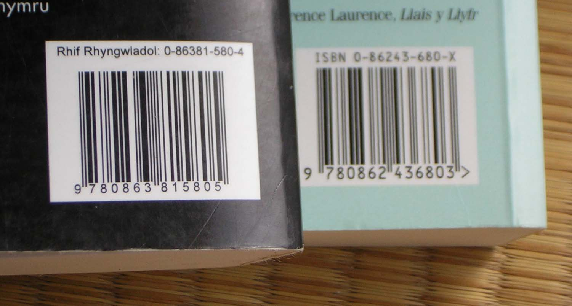


Persistent Identifiers
Cars
(and countries)
Books
Research Papers
Scientists

Slide 28
URLs
RDF solution is to use URLs
Globally unique (by the Web)
Existing standards
Readable

Slide 29
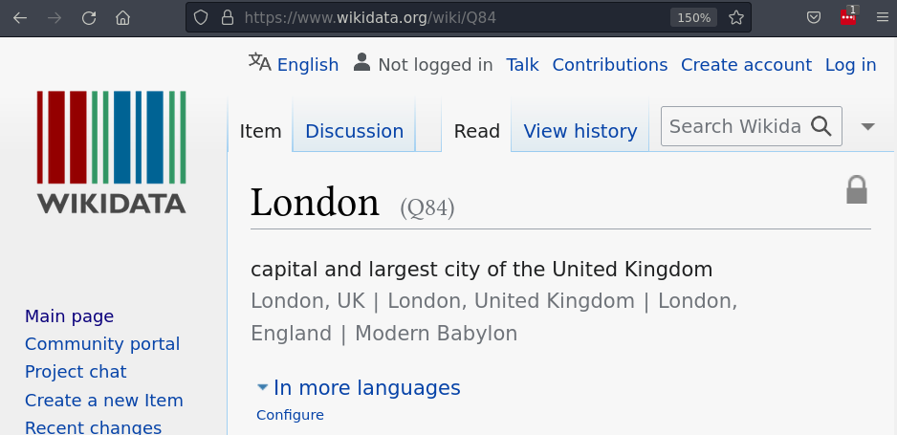
URLs and identity
But does https://en.wikipedia.org/wiki/London refer to the city or the article about the city??
Use data URLs https://www.wikidata.org/entity/Q84
Click link in browser
More on this in Week 10

Slide 30
Same As
dbo:country
dbpedia:United_Kingdom
https://www.wikidata.org/entity/Q84
‘Same as’ means the URLs are fully interchangeable
sameAs
http://dbpedia.org/resource/London
dbo:country
dbpedia:United_Kingdom

Slide 31

Lexicalization
dbpedia:Swaziland
redirect
dbpedia:Eswatini
“Eswatini”@en
wikidata:Q1050
“Umbuso weSwatini”@ss
label
“Ríocht Esuaitíní”@ga
More on this in Week 11

Slide 32
Context

Slide 33

Context
Since 1946
airport
London
Heathrow

Slide 34
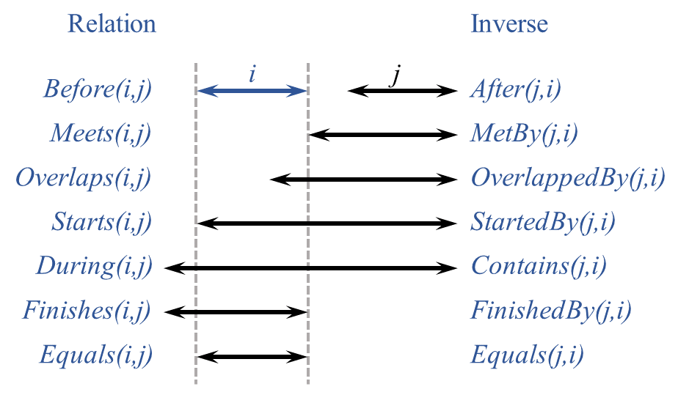
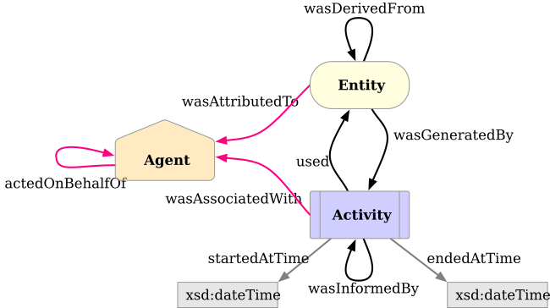
Context Ontologies
We can represent this as ‘normal’ triples
Time Ontology
PROV-O: Provenance Ontology

Slide 35
RDF Reification
London
airport
rdf:subject
rdf:predicate
rdf:object
Heathrow
e
validFrom
1946

Slide 36
n-ary Relations
New property with different range
xl:airport
London
e
validFrom
value
1946
Heathrow

Slide 37
Singleton property
airport
1946
subPropertyOf
validFrom
e
London
Heathrow
Relies on ‘punning’: Using the same identifier for both an edge and a node in the graph

Slide 38
Named Graphs
We can also pun the name of the graph.
Efficient for many statements, but abuses identifiers and graph names!
airport
London
Heathrow
e
validFrom
1946

Slide 39
RDF*
Extension to RDF to allow triples to be nodes themselves:
airport
validFrom
London
Heathrow
1946
<<:London :airport :heathrow>> :validFrom “1946”^^xsd:year .

Slide 40
Discussion
What are the advantages/disadvantages of each method?
When might you use each method?

Slide 41
Summary

Slide 42
Schemas, shapes, identity, context
Schemas
Allow us to infer information in graph
Only infers new information
Shapes
Describe validation constraints on graphs
Cardinality, range, required properties

Slide 43
Schemas, shapes, identity, context
Identifiers in graph should be globally unique
URLs are a solution to this
Still challenges
Facts in graph only true in context
Reification allows representation within RDF
Special extensions such as RDF* also exist

Slide 44
Questions?

